Slide 1

Advanced Disk Scheduling Simulator
Group Members: Aquib Jawaid Ansari (12508688), Prathamesh Gadewar (12500420), Prabhjot Singh (12508327)
Department of Computer Science and EngineeringLovely Professional University, Jalandhar Under the Guidance of Miss Kriti Mathur

Slide 2

Project Overview
Objective
Create an interactive, web-based educational tool that demonstrates how various disk scheduling algorithms operate in modern operating systems. This simulator transforms complex theoretical concepts into visual, hands-on learning experiences.
Key Features
Visual representation of disk head movements
Real-time request servicing animation
Performance metrics dashboard
Cross-platform compatibility

Slide 3



System Architecture
The simulator comprises six interconnected modules working together to deliver a seamless educational experience.
User Interface Module
Simulation Engine
Visualization Layer
Captures user inputs including disk size, initial head position, and request sequences. Renders the complete visual simulation experience.
Core processing unit that executes selected algorithms (FCFS, SSTF, SCAN, C-SCAN) and manages scheduling logic.
Provides real-time animation of disk head movement across cylinder positions with smooth transitions.
Performance Metrics
Control Module
Educational Layer
Calculates and displays comprehensive statistics including seek distance, average times, and throughput measurements.
Manages simulation lifecycle with start, pause, reset, and step-through debugging capabilities.
Delivers contextual tips, algorithm explanations, and comparative insights to enhance learning outcomes.

Slide 4
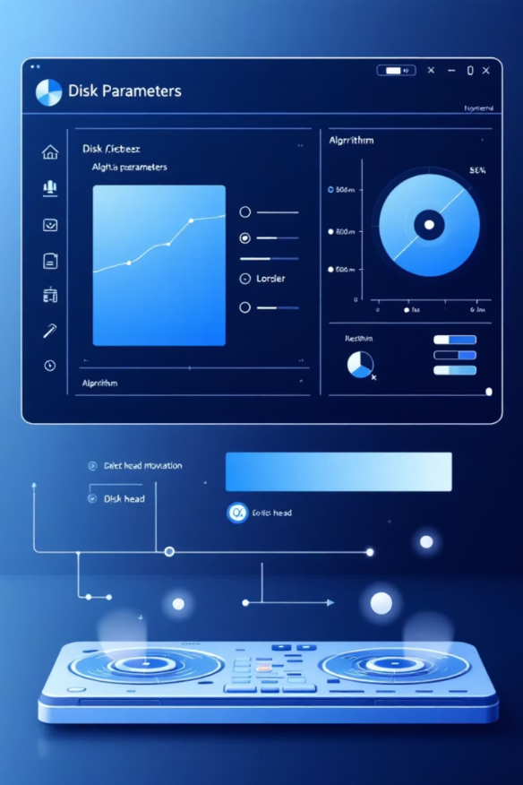
Core Functionalities
Input & Control
Algorithm selection interface
Configurable disk parameters
Custom request queue input
Simulation control buttons
Simulation & Visualization
Animated disk head movement
Sequential request servicing display
Color-coded status indicators
Performance Evaluation
Order of cylinder access
Total seek distance calculation
Average seek time computation
Throughput analysis
Educational Insights
Side-by-side algorithm comparison
Performance impact visualization
Best-case/worst-case scenarios

Slide 5





System Flow Architecture
User Input
Algorithm selection, disk size configuration, head position, and request queue definition
Simulation Engine
Executes the selected scheduling algorithm and processes request sequences according to algorithm rules
Metrics Calculation
Computes order of access, total seek distance, average seek time, and overall throughput values
Visualization Layer
Generates animated graphical representation of disk head movement across cylinder positions
Results Display
Presents comprehensive performance metrics, access logs, and comparative analysis to the user

Slide 6








Technology Stack
Core Technologies
HTML5
CSS3
Semantic structure, canvas elements, and responsive layout foundation
Modern styling with flexbox/grid layouts, custom animations, and theme implementation
JavaScript ES6
Core simulation logic, DOM manipulation, event handling, and animation engine
Built entirely with modern web standards for maximum compatibility and ease of deployment.
Development Tools
Vanilla JS
VS Code
No external frameworks—pure JavaScript for lightweight performance
Primary development environment with debugging capabilities
GitHub
Live Server
Version control and collaborative development platform
Real-time testing environment with hot reload functionality

Slide 7
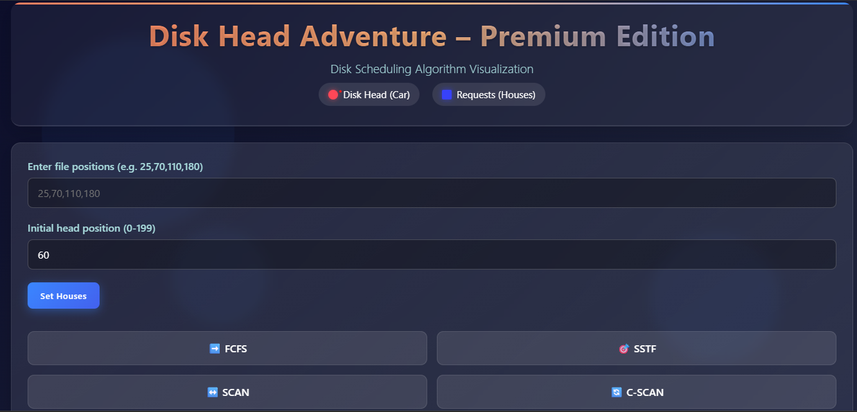
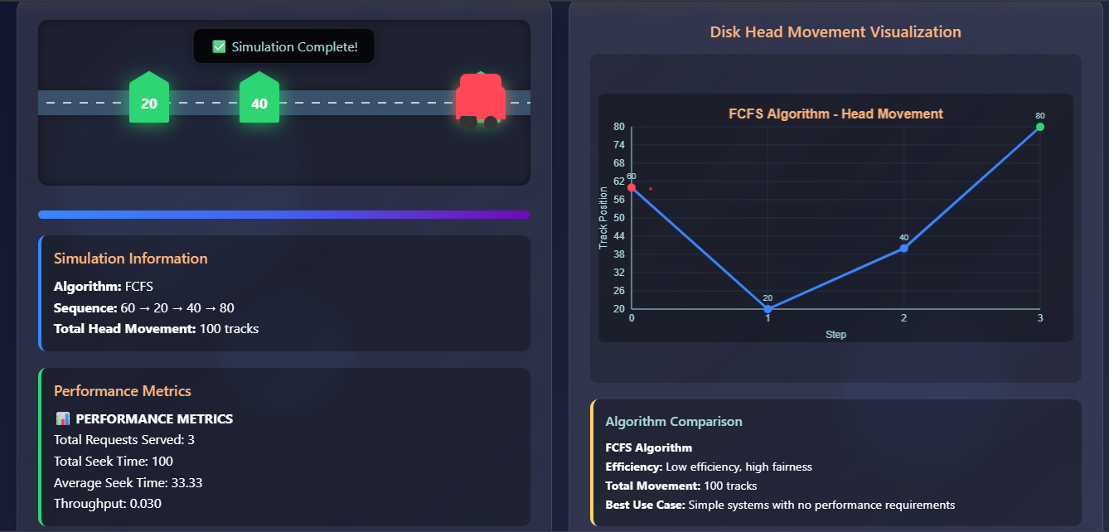
Screen Shot Of The Web Page

Slide 8

Conclusion
Interactive Learning
Performance Insights
The simulator transforms abstract concepts into tangible, visual experiences that enhance comprehension of disk scheduling mechanisms.
Real-time performance metrics enable students to understand the trade-offs between different scheduling algorithms in practical scenarios.
Educational Impact
Bridges the gap between theoretical operating systems concepts and practical implementation, benefiting both students and educators.
"By visualizing complex algorithms in action, this simulator makes operating systems concepts accessible and engaging for learners at all levels."

Slide 9





Future Enhancements
Planned improvements to expand functionality and enhance user experience in upcoming versions.
Additional Algorithms
Implement LOOK and C-LOOK scheduling algorithms to provide comprehensive coverage of disk scheduling techniques.
Graphical Comparisons
Integrate interactive charts and graphs for visual comparison of algorithm performance metrics side-by-side.
Export Capabilities
Enable users to export simulation results as PDF reports or CSV files for academic documentation and analysis.
Mobile Optimization
Enhance responsive design for seamless operation on tablets and smartphones with touch-friendly controls.
AI-Based Scheduling
Introduce machine learning algorithms that adapt scheduling strategies based on historical request patterns and workload analysis.

Slide 10
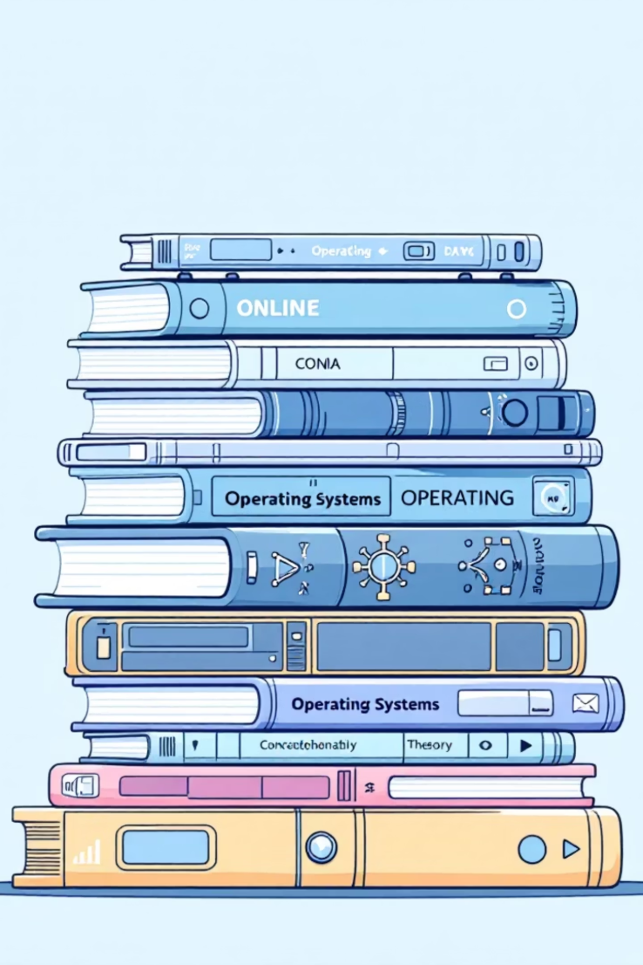

References
1
2
Operating Systems: Internals and Design Principles
Operating System Concepts
William Stallings, 9th Edition, Pearson Education. Comprehensive coverage of OS fundamentals and scheduling algorithms.
Silberschatz, Galvin, and Gagne, Wiley Publications. The definitive textbook on operating systems theory and practice.
3
Online Resources
Various educational websites, documentation, and research papers on disk scheduling algorithms and operating systems concepts.

